Slide 1

Recipe Recommendation
Project Proposal
Blessy Kuriakose, Aniv Chakravarty, Sathwik Reddy Rajidi
CSCE 5200.002 – (Information Retrieval)
March 10, 2023

Slide 2
Abstract
This project aims to develop a recipe recommendation system that suggests new recipes to users based on their preferences and the preferences of other users with similar tastes. The goal is to provide users with a personalized list of recipe recommendations that they haven't tried before and that are highly relevant to their preferences. The system is designed to save users time and effort when looking for new recipes and help them discover new and exciting meals that they'll love.

Slide 3

Introduction
Motivation
Goals
People can spend hours looking up a workable recipe on the web only for them to find that they are missing crucial ingredients or for it to end up not suiting their palette.
The job of this recommendation system is to alleviate these concerns and make cooking an easy process with fruitful results.
This system should be able to…
Filter recipes by ingredients.
Analyze user preferences using sentiment analysis on past reviews.
Cluster reviewers to predict new recipes the user might enjoy.
Rank recipes using the above factors and display them as options.
Notes:
image from Kaggle.

Slide 4
Workflow
03
04
05
W1
W2
W3
W4
W1
W2
W3
W4
W1
W2
Proposal
3/10
Data Exploration
MAIN
Coding
Testing
Final Report & Presentation
5/?

Slide 5
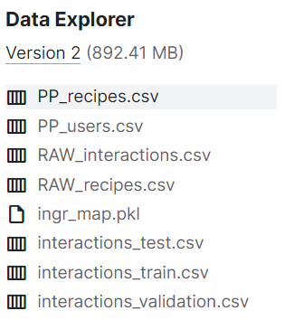
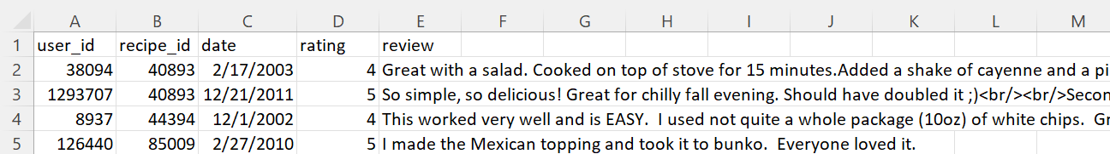
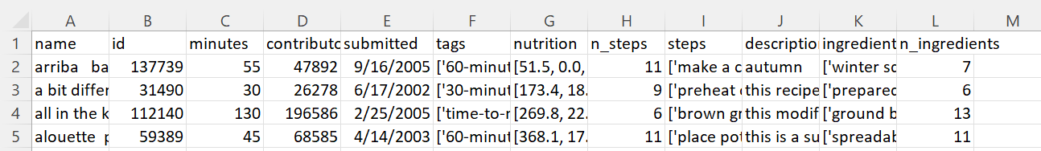
Introduction
Dataset
We will be using a dataset from Kaggle which contains over 180K recipes and 700K reviews collected from 18 years of data from Food.com
Below is an outline of how the raw data is provided from kaggle’s site. There is also a preprocessed version with encoded text (text->numerical) available in Kaggle.

Slide 6
Related Works
Recommendation System Basics –with insights from Analytics Vidhya
Prediction models have been in use for recommendations for a while in industry and they have only gotten better over time. Whether it’s targeted ad on Youtube, suggestions of “others who purchased this have also purchased” items on Amazon, or new show recommendations on Netflix, the traces of your past with combination of big data can be used in predicting what you like and will choose in the future. These systems save time and effort in many fields, encouraging use by lowering typical resistance factors.
Basic Types of Recommendation Systems
Content-based | Collaborative
- | Item-based | User-based
Notes:
other websites:
https://towardsdatascience.com/user-to-user-vs-item-to-item-collaborative-filtering-explained-through-simple-examples-part-1-f133bec23a58
https://stackoverflow.com/questions/16372191/whats-difference-between-item-based-and-content-based-collaborative-filtering

Slide 7
Related Works
Personalized Recipe Recomm… – ResearchGate
“Personalized Recipe Recommendation System using Hybrid Approach” claims to take a step further from the conventional recommendation approach by adding in various categories of filter. This paper uses a web crawler to retrieve 10,971 recipes and their reviews from food.com. (Same source as the dataset from Kaggle.) Their task takes the approach of predicting user ranking given recipe content and historical user ranking, through which they cluster users via a KNN model. They also implement a second approach using stochastic gradient descent. Our approach is similar in the clustering ideology, however we aim to cluster groups based on reviews instead of recipe content.

Slide 8
Related Works
Scalability – CANTOR (Jiang et. al., 2020)
Creating clusters and calculating distance on Large scale is time consuming especially when incorporating collaborative recommendation and preferences. So instead we obtain a subset of the preferences and their centroid representing the users latent vectors which are represented on the item latent vector. Essentially finding key overlapping points that can be used to save on the overall computation time. They evaluated their model on recommendations and predictions on some well known datasets like Wikipedia and Amazon to see the computation speed up rate which resulted in almost double to triple speed up compared to other methods likes GMIPS, SVDS, FGD and L2S

Slide 9
Related Works
Relational Data… – HGAT (Tian et. al., 2021)
Hierarchical Graph attention network model (HGAT) uses relation level attention module on embeddings on a heterogeneous recipe graph where each is of three types which are recipe, ingredients and users while edges are relations between the nodes. Attention modules are used on a node and relation level. They claim that the use of a neural network approach by considering the relations helped them achieve better performance to their baseline approaches like BPR, IngreNet, GAT etc., since they were able to capture more feature details along with their score and ranking based optimization functions.

Slide 10
Related Works
Sentiment Analysis using product review data - (Fang et. al., 2015)
Sentiment analysis or opinion mining is one of the major tasks of NLP (Natural Language Processing). Sentiment analysis has gain much attention in recent years. In this paper, we aim to tackle the problem of sentiment polarity categorization, which is one of the fundamental problems of sentiment analysis. A general process for sentiment polarity categorization is proposed with detailed process descriptions. Data used in this study are online product reviews collected from Amazon.com. Experiments for both sentence-level categorization and review-level categorization are performed with promising outcomes. At last, we also give insight into our future work on sentiment analysis.

Slide 11
Model Description
Flowchart
Sentiment Analysis
on reviews.
User inputs ingredients
User clustering based on past reviews
<< KNN is our model of choice for this process.
Ingredients filtering
Plausible recipes
Recipe reviews by common cluster
If not enough plausible recipes are returned.
Ranked Results
Add common ingredients (can be deselected by user.)
← Maybe as an intersection between ingredients in high ranked recipes and in recipes the user has previously reviewed. (By top occurrence counts.)

Slide 12
References
https://github.com/NikhilReddy0608/Food-Recipe-Recommendation
https://www.analyticsvidhya.com/blog/2021/07/recommendation-system-understanding-the-basic-concepts/
https://www.researchgate.net/publication/327281659_Personalized_Recipe_Recommendation_System_using_Hybrid_Approach
https://dl.acm.org/doi/10.1145/3366423.3380283
https://www.frontiersin.org/articles/10.3389/fdata.2021.778417/full
https://journalofbigdata.springeropen.com/articles/10.1186/s40537-015-0015-2

